Slide 1
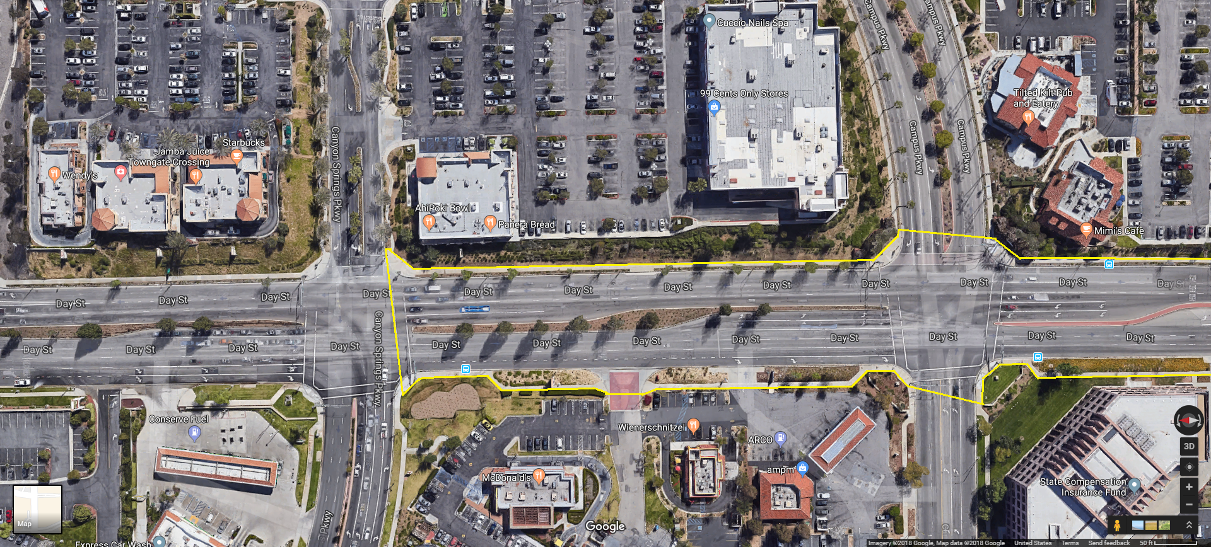
Area 1 of 2

Slide 2
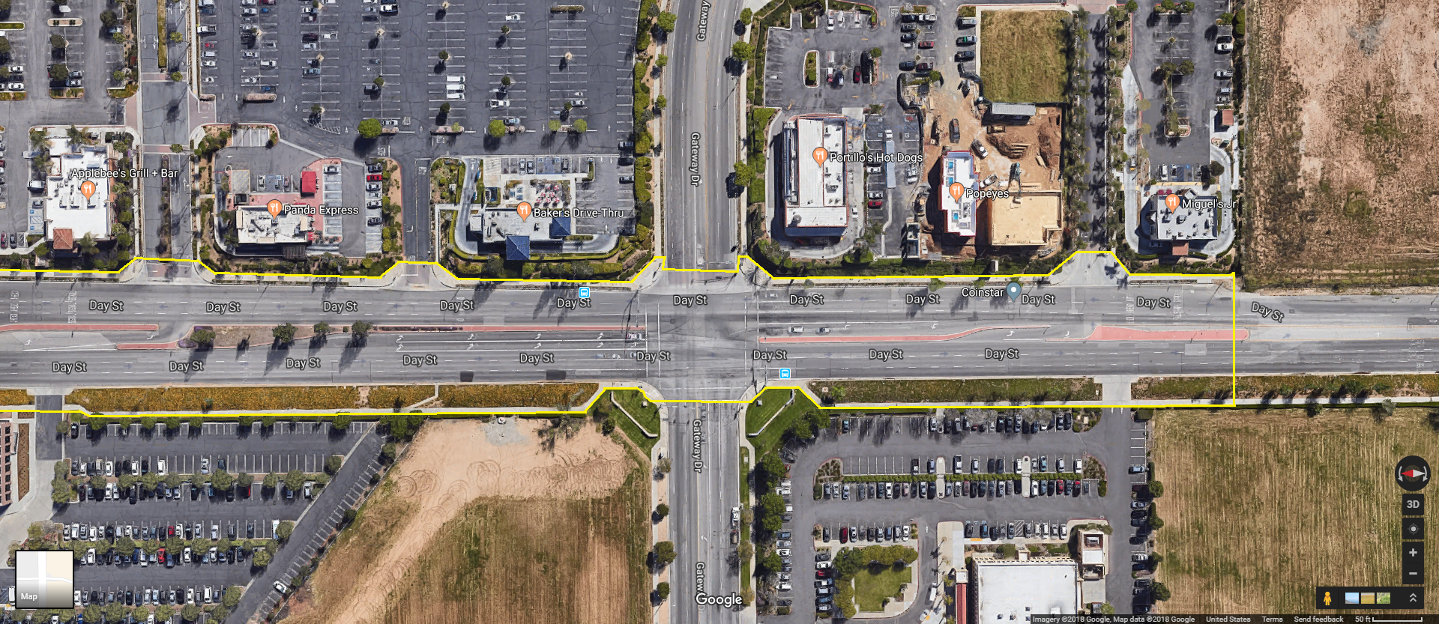
Area 2 of 2

Slide 3
Combined Areas
(Complete Study Site)

